Slide 1
CSE 486/586 Distributed Systems The Internet in 2 Hours: The First Hour
Steve Ko
Computer Sciences and Engineering
University at Buffalo

Slide 2
Today and Monday
A brief overview of the Internet
Two things
The design philosophy of the Internet (“The Design Philosophy of the DARPA Internet Protocols” by David Clark): today
Transport & application layers: Monday
Obviously can’t replace a networking course; please take it if you haven’t---it’s interesting!
Why teach these?
Because I want to ;-)
If there’s no network, there’s no distributed system.
Not just that: the design of the Internet is a great example of designing a solid distributed system.

Slide 3
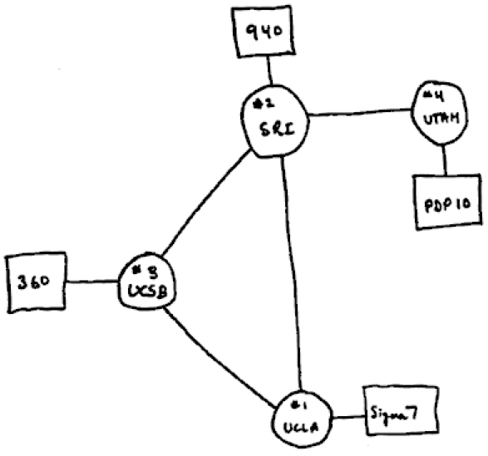
What Is the Internet?
1969

Slide 4
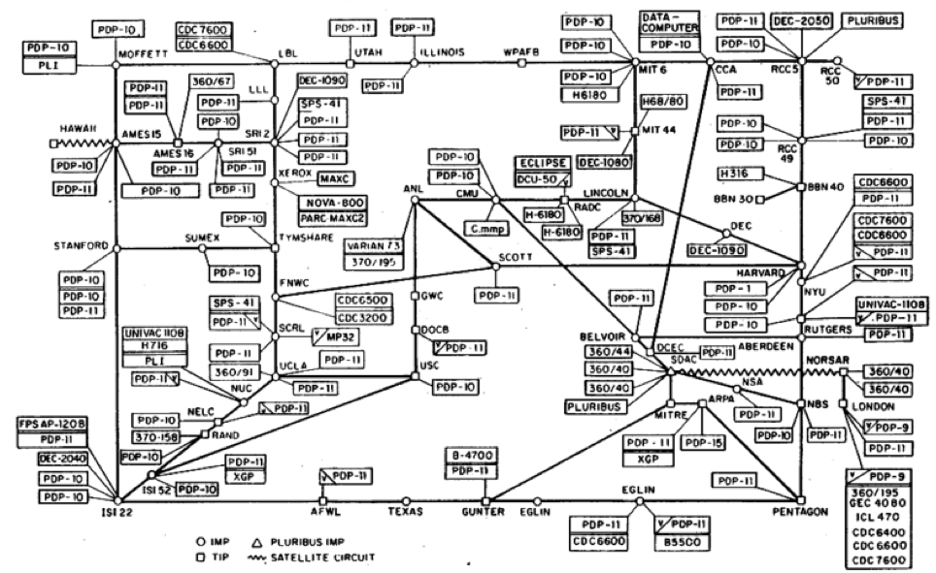
What Is the Internet?
1977

Slide 5
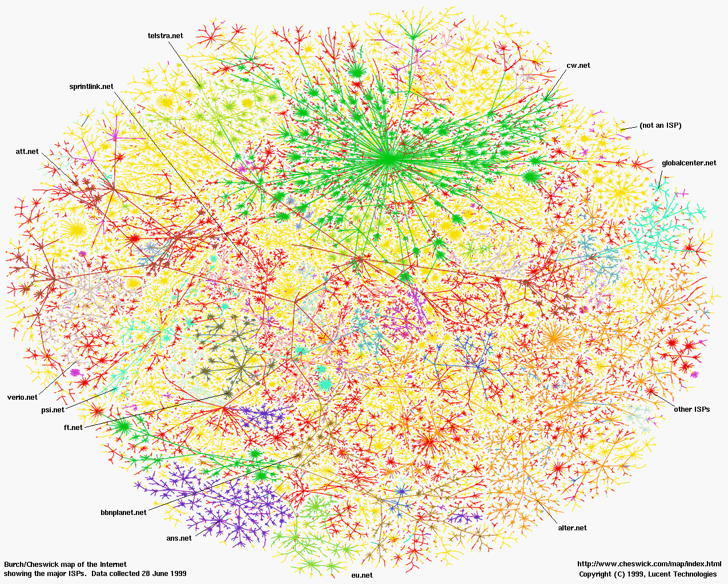
What Is the Internet?
Now
A network of networks
The fundamental goal of the original designers: interconnecting different networks by designing common protocols

Slide 6
Detour: What is a Protocol?
Example: making an appointment
Well…I think we need a better way…
Please meet with me for
1.5 hours starting at
1:30pm on February 8, 2006?
Please meet with me for
1.5 hours starting at
3:00pm on February 8, 2006?
Please meet with me for
1.5 hours starting at
4:30pm on February 8, 2006?
I can’t.
I can’t.
Yes!

Slide 7
Detour: What Is a Protocol?
Bob: When are you free to meet for 1.5 hours during the next two weeks?
Alice: 10:30am on Feb 8 and 1:15pm on Feb 9.
Bob: Book me for 1.5 hours at 10:30am on Feb 8.
Alice: Yes.

Slide 8
Detour: What is a Protocol?
An agreement between entities in communication
Two things: 1) syntax, 2) semantics
Syntax
What language?
What’s the time format? Granularity?
Etc.
Semantics
If broken into pieces, how do you reassemble?
If a msg gets lost, what do you do?
If you get a msg, what do you do?
Etc.

Slide 9
Returning back: What Is the Internet?
A network of networks
The fundamental goal of the original designers: interconnecting different networks by designing common protocols

Slide 10
How to Interconnect?
There were many types of networks based on various physical media.
Coax, radio, satellite, etc.
The original designers wanted to interconnect those somehow.
A potential solution
Designing a “multi-media” network (e.g., via physical signal translator for various physical media)
Solution chosen?
Hint: “All problems in computer science can be solved by another level of indirection.” --- David Wheeler
Layering with packet switching
(We will not cover packet switching vs. circuit switching)

Slide 11
Layering: A Modular Approach
Sub-divide the problem
Each layer relies on services from layer below
Each layer exports services to layer above
Interface between layers defines interaction
Hides implementation details
Layers can change without disturbing other layers
“The” computer science approach
ISA, OS, networking…
Application
Application-to-application channels
Host-to-host connectivity
Link hardware

Slide 12
Internet 5-Layer Stack
This is what it ultimately evolved into.
This is where all distributed algorithms/techniques run
Message
Layers
Application
Messages (UDP) or Streams (TCP)
Transport
UDP or TCP packets
Network
IP datagrams
Data Link Layer
Network-specific frames
Underlying network

Slide 13
IP Suite: End Hosts vs. Routers
host
host
HTTP message
HTTP
HTTP
TCP segment
TCP
TCP
router
router
IP
IP packet
IP packet
IP packet
IP
IP
IP
Ethernet
interface
Ethernet
interface
SONET
interface
SONET
interface
Ethernet
interface
Ethernet
interface

Slide 14
The Internet Protocol Suite
FTP
HTTP
NV
TFTP
Applications
TCP
UDP
UDP
TCP
Waist
IP
Data Link
NET₁
NET₂
…
NET_{n}
Physical
The Hourglass Model
The waist facilitates interoperability

Slide 15
Why That Way?
Let’s dig deeper…
In the order of importance
Internet communication must continue despite loss of networks or gateways.
The Internet must support multiple types of communications service.
The Internet architecture must accommodate a variety of networks.
The Internet architecture must permit distributed management of its resources.
The Internet architecture must be cost effective.
The Internet architecture must permit host attachment with a low level of effort.
The resources used in the Internet architecture must be accountable.

Slide 16
Survivability
Was the (second) most important design priority
(First was incorporating heterogeneous networks via packet switching)
Why? Military context
What does it mean?
“if two entities are communicating over the Internet, and some failure causes the Internet to be temporarily disrupted and reconfigured to reconstitute the service, then the entities communicating should be able to continue without having to reestablish or reset the high level state of their conversation.”
What does it mean?
As long as there is a physical path, two entities should be able to talk without reestablishing or resetting the conversation.
There is only one failure---total partition.

Slide 17
So, How to Protect a Conversation?
Think about the following scenario
Hey!
The Internet
Hey!

Slide 18
Two Approaches to Survivability
Approach 1: “stateful” network
The network keeps the state information about conversations
Hey!
The Internet
OK; Bob is sending something to Alice.
I’d better keep another copy in case it gets lost…

Slide 19
Two Approaches to Survivability
Approach 2: “stateless” network
The end keeps the state information about conversations
Hey!
(and let me know if you receive this)
(OK; Alice didn’t speak to me for a while. I’ll send it again.)
The Internet

Slide 20
Two Approaches to Survivability
Stateless networks’ principle: fate-sharing
The conversation shares the same fate with the “end”
“it is acceptable to lose the state information associated with an entity if, at the same time, the entity itself is lost.”
Advantages
Fate-sharing protects against any number of intermediate failures (what about replication?)
Fate-sharing is much easier to engineer.
The result: dumb pipes
IP doesn’t really provide anything other than “best-effort” delivery.
The end hosts need to deal with reliability issues.
Is this always a good thing?
Is today’s Internet still stateless?

Slide 21
IPv4 Packet
4-bit
Version
4-bit
Header
Length
8-bit Type of
Service (TOS)
16-bit Total Length (Bytes)
3-bit
Flags
16-bit Identification
13-bit Fragment Offset
8-bit Time to
Live (TTL)
20-byte
header
8-bit Protocol
16-bit Header Checksum
32-bit Source IP Address
32-bit Destination IP Address
Options (if any)
Payload

Slide 22
TCP
Part of the effort to keep the network stateless
Takes care of reliability issues
A conversation can survive under transient failures in the Internet.
What are those issues?
Packet loss
Packet corruption
Duplicate packets
Out-of-order delivery
Congestion
Insufficient buffer at the end hosts
TCP is an abstraction: reliable, in-order byte stream

Slide 23
Acknowledgements
These slides contain material developed and copyrighted by
Indranil Gupta at UIUC
Mike Freedman and Jen Rexford at Princeton

